Slide 1
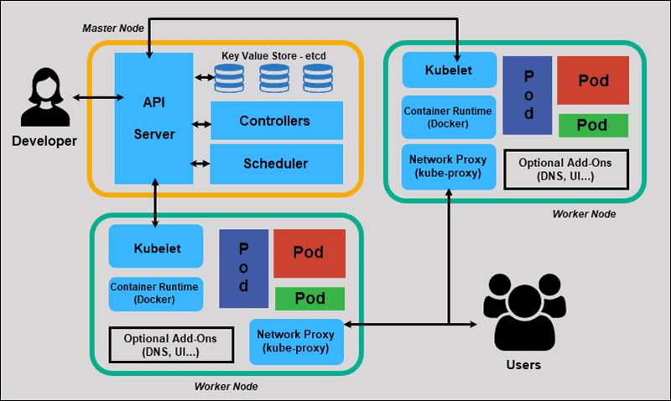
KUBERNETES MAIN COMPONENTS

Slide 2
api - server
The API server is a component of the Kubernetes control plane that exposes the Kubernetes API. The API server is the front end for the Kubernetes control plane.

Slide 3
ETCD
Consistent and highly-available key value store used as Kubernetes backing store for all cluster data.
It will store key value pairs and master and worker data

Slide 4
scheduler
In kubernete scheduling refers to making sure that pods are matched to nodes so that kublet can run them
Control plane component that watches for newly created Pods with no assigned node, and selects a node for them to run on.

Slide 5
controller-manager
Control plane component that runs controller processes.
Logically, each controller is a separate process, but to reduce complexity, they are all compiled into a single binary and run in a single process

Slide 6
Node Components
An agent that runs on each node in the cluster. It makes sure that containers are running in a Pod.
The kubelet takes a set of PodSpecs that are provided through various mechanisms and ensures that the containers described in those PodSpecs are running and healthy.

Slide 7
Container runtime
The container runtime is the software that is responsible for running containers.

